Slide 1


Analysis of Customer Churn in Airlines Industry
IST 687
Rashika Singh

Slide 2
Problem Statement
Southeast Airlines needs to lower the customer churn
Loyalty program is not useful, and the airlines is losing customers
How can the airlines retain its customers?

Slide 3
About the data
The dataset has 5,000 rows and 31 columns
The dataset has 2820 female travelers and 2180 male travelers
There are :
4 categories of Airline status- Blue, Gold, Platinum, Silver
3 categories of travel- Business, Mileage and Personal

Slide 4
Business Questions
What age groups travel the most so that effective marketing strategies can be used?
Which gender is the promoter for the airlines, and which is detractor?
What is the NPS across different airlines?
What is the reason for low NPS?
Does type of travel affect likelihood to recommend?
Which airlines can Southeast Airlines partner with?

Slide 5
Project flow
Data loading and cleaning
Exploratory Data Analysis
Adding attributes
Linear modeling
Association rules mining
Support vector machine
Recommendations

Slide 6
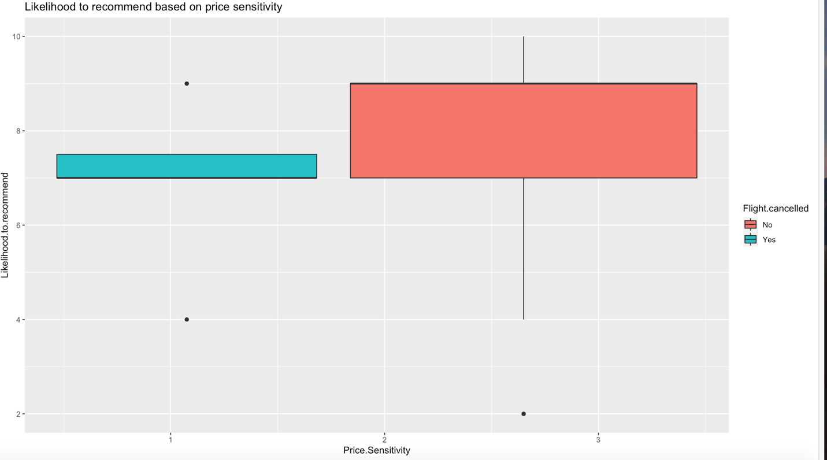
Likelihood to recommend based on flight cancellations and sensitivity

Slide 7
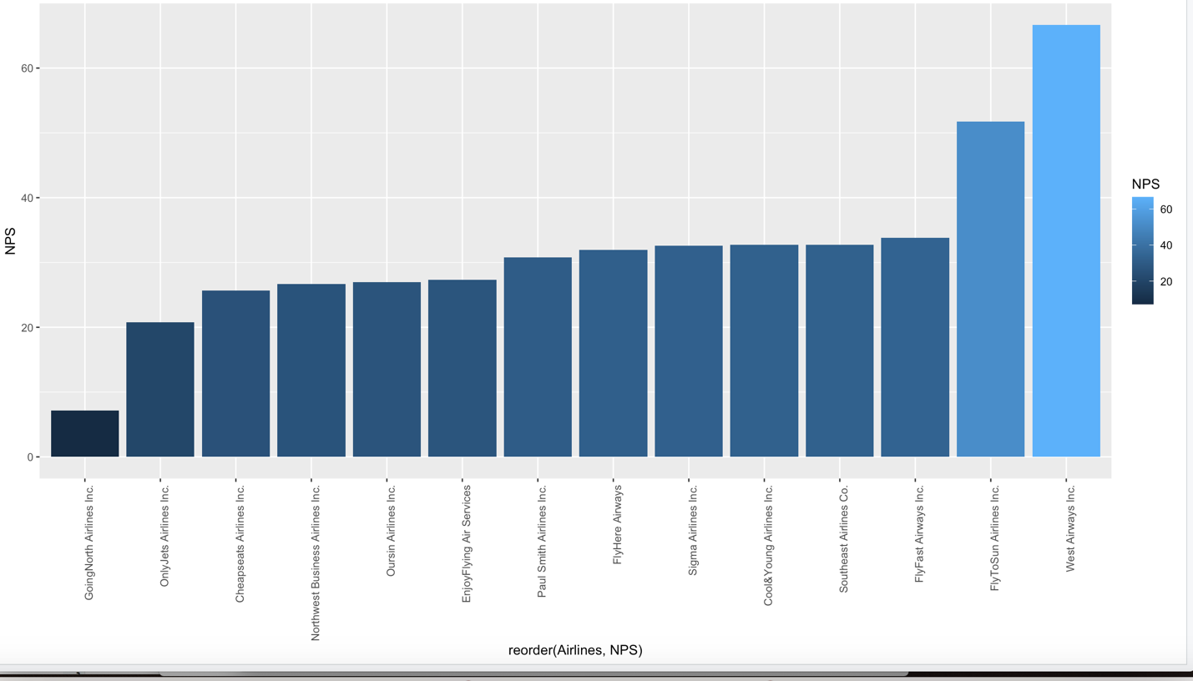
Comparing NPS across airlines

Slide 8
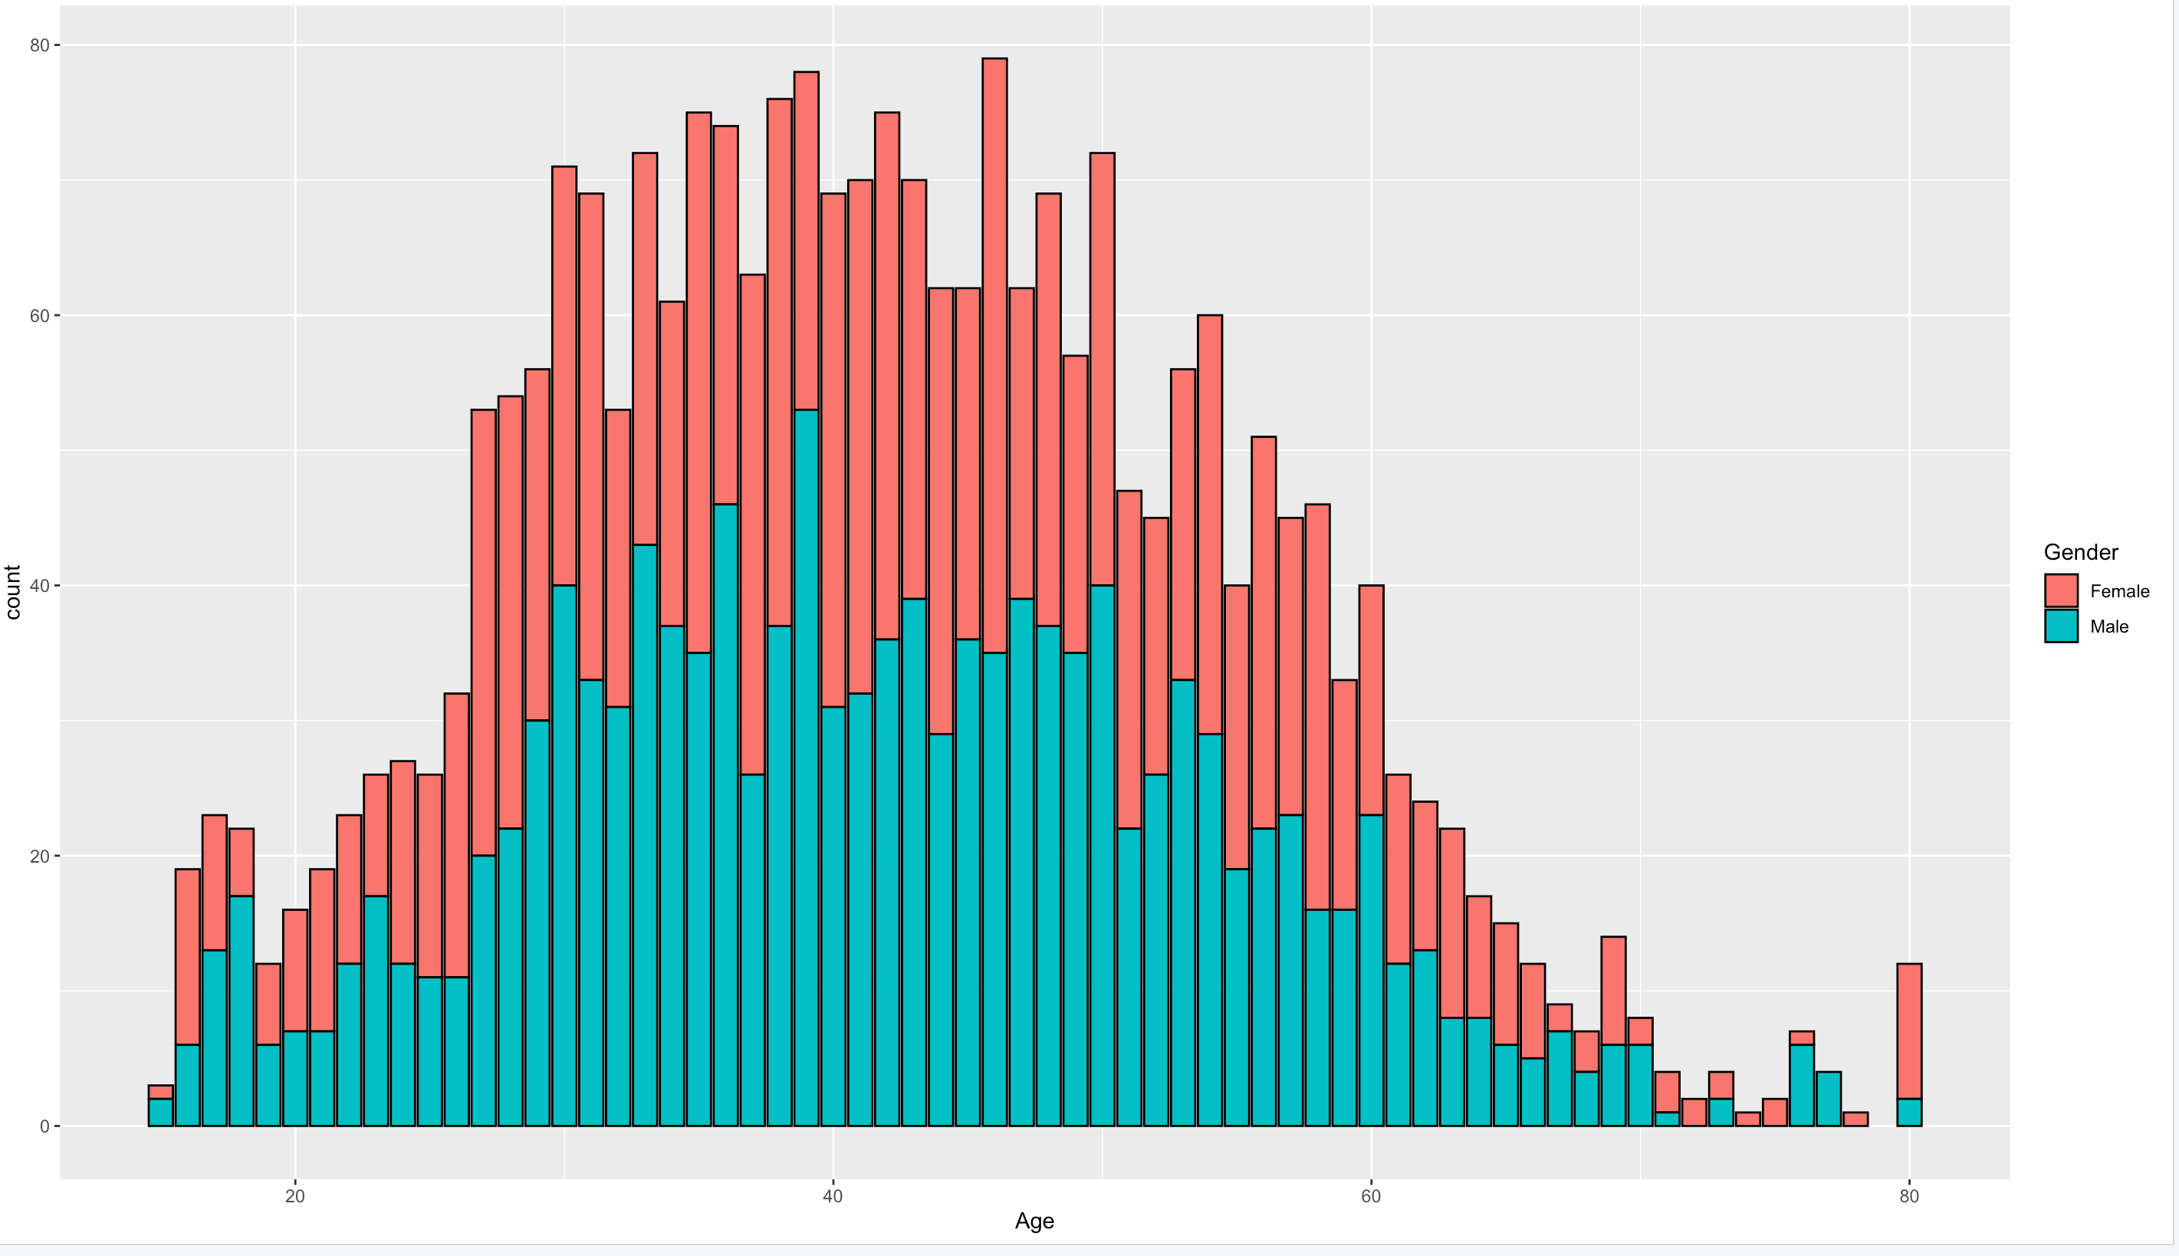
Promoter Data for likelihood by gender

Slide 9
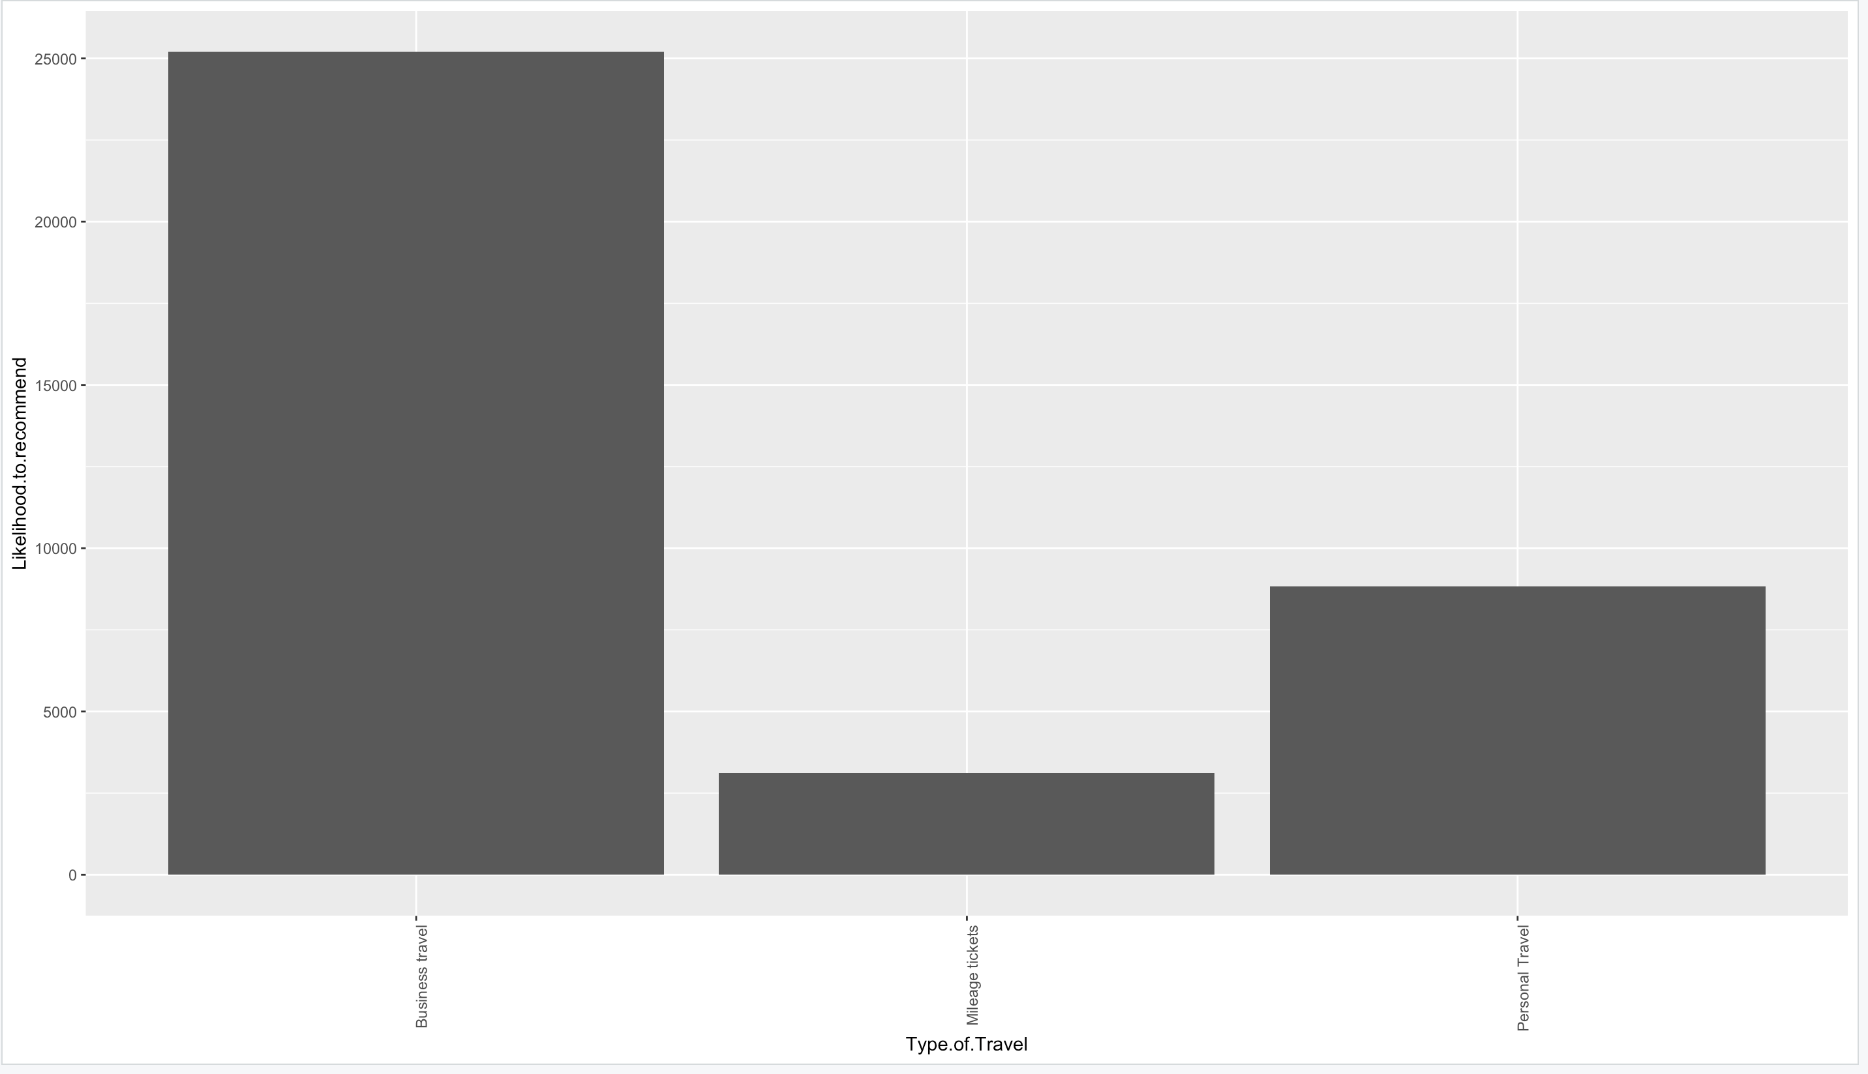
Likelihood to recommend based on Travel type

Slide 10
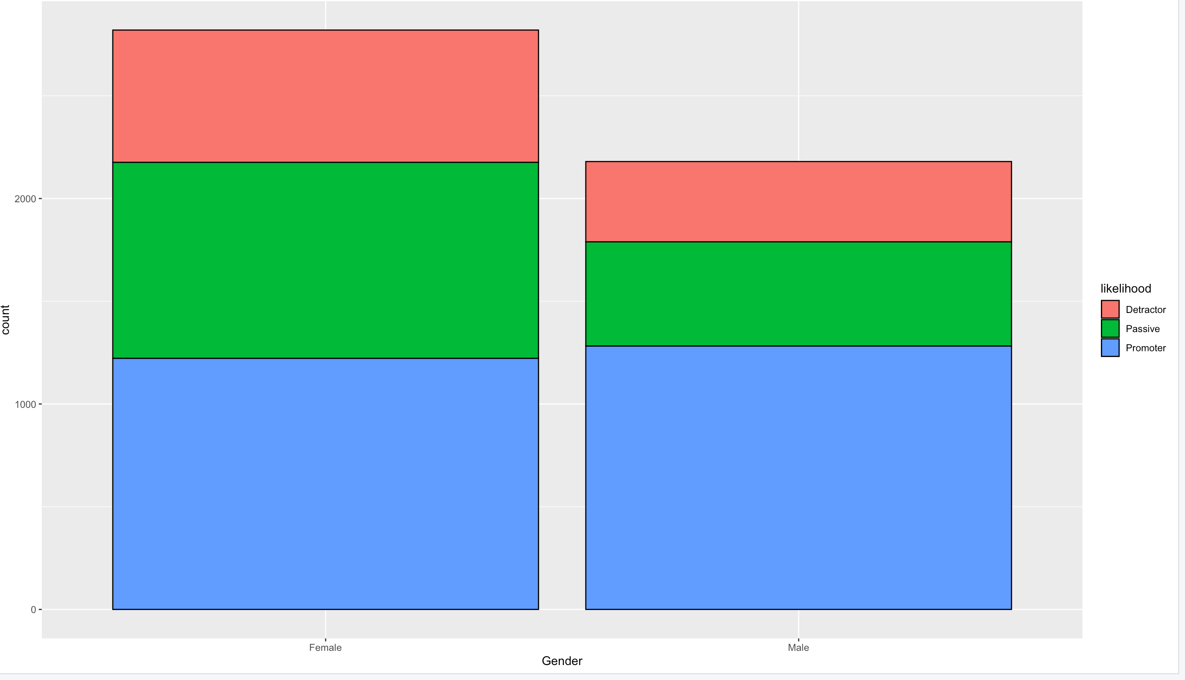
Likelihood to recommend based on gender

Slide 11
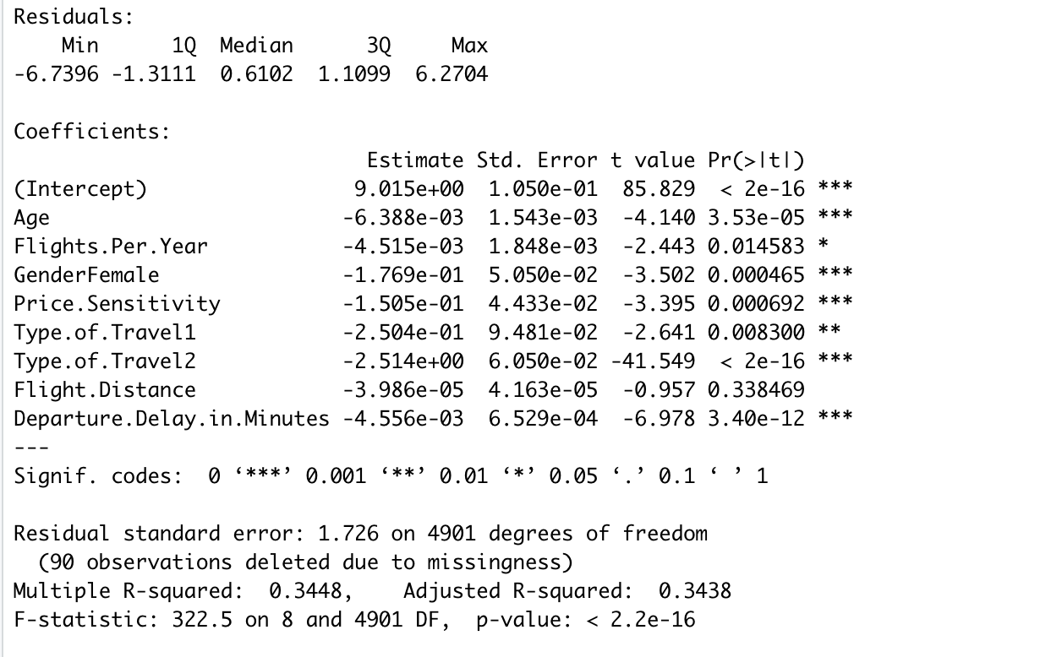
Models
Linear Modeling
Age
Gender
Price Sensitivity
Type of Travel
Flight Distance
Departure Delay

Slide 12
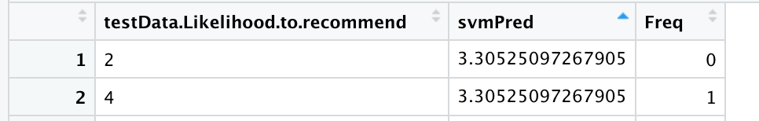
Models
Support Vector Machine
Gender
Age
Type of travel
Flight Distance
Departure Delay

Slide 13
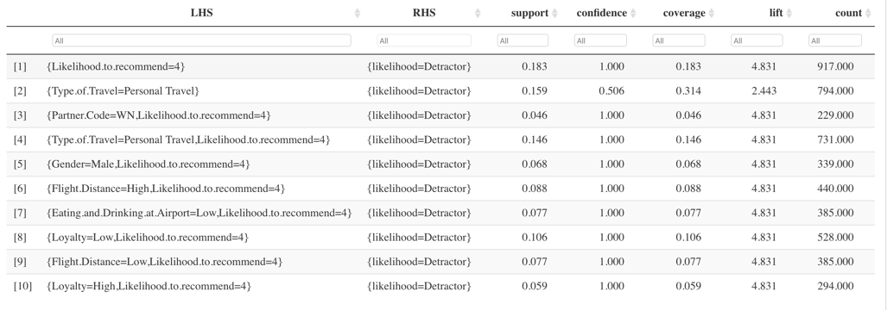
Models
Association Rule Mining
Predicting Detractor rules

Slide 14
Recommendations
Female customers are more than male customers, but they have a lower likelihood to recommend and hence better marketing ads and services could be given to female customers.
The age group of customers traveling is in the range of 30-50 years hence, better deals can be given to them to meet their demands.

Slide 15
Recommendations
West Airways has a good NPS score so the customer can promote the airlines with their acquaintances so South East Airlines can do a market study of the airlines and partner more with the airlines.
Customers with average number of flights per year are promoters so loyal customers with special benefits so that each customer is interested to fly with the airlines to increase its loyalty.

Slide 16
Recommendations
A lot of promoter’s travel business class so facilities in economy class could be improved in order to attract a greater likelihood of recommendation.
The Southern part of USA have many promoters, but efforts can be taken to improve the quality of service in the other parts.
Airlines should provide services like medical aid, wheelchairs to people over 50 as they can be detractors.

